Slide 1
APS-PEAS Prototype and Risk Study
APS Software
Procedure Executive and Analysis Software (PEAS)
Scott Michaels
September xx, 2009
Information in this document is proprietary to JPL/Caltech, The University of California, and the TMT Observatory Corp. It is not for distribution without their prior written approval.
Technical data in this document is controlled under U.S. Export Regulations and may not be released to foreign persons without proper authority.
TMT.TEL.CDD.XXX.XXX

Slide 2
Outline
Contract Scope
Risks Studied
Benefits of Prototyping
Prototype Overview
Computation Design and Language Interoperability Demo
Workflow Designer Demo
Workflow Engine and Distributed Architecture Demo
RCP UI Demo
Results of Risk Study
Next Steps
TMT.TEL.CDD.XXX.XXX

Slide 3
Contract Summary
Contract TMT.BUS.CON.07.085.REL01 and amended contract TMT.BUS.CON.09.030.REL01
Contract Time Spent (since APS CoDR) 1/1/08 - 7/1/09
Contract Item | Man-Hours | Man-Weeks
Risk Study/Prototyping | 178 | 4.5
APS and Project Review Support | 74 | 2.0
SMP work | 57 | 1.5
Demo Prep | 0 | 0
TMT.TEL.CDD.XXX.XXX
Notes:
Move to first presentation

Slide 4
Risk Study
Procedure design technologies, language and tools
  Is XPDL a suitable language for the workflow needs of APS?
  Impact to cost/schedule of building workflow designer in house.
Procedure execution architecture framework
  Is a workflow solution a feasible one for APS?
  Impact to cost/schedule of building workflow engine in house.
Rich Client Platform User Interface
  Target platform: Eclipse RCP
  Suitability for APS design and operational use cases
Distributed and scalable CCM (Container Component Model) architecture.
  Prototype to determine any unforeseen problems with the proposed architecture.
Language interoperability design
  Feasibility of approach to Language interoperability. What are the performance costs?
TMT.TEL.CDD.XXX.XXX

Slide 5
Benefits of Prototyping
Benefits of Prototyping a Workflow Designer
  Flesh out detailed APS requirements for a workflow designer
    To guide future design and technology choices
  Gain understanding of XPDL and its applicability as a solution for the workflow.
  Refine cost/schedule impacts of building a designer tool in house
  Determine if Eclipse RCP can be used as a UI for the designer tool.
Benefits of Prototyping a Workflow Engine
  Determine feasibility of approach
  Flesh out APS requirements for a workflow engine
  Use prototype to determine/compare framework performance overhead
  Get a better feel for any previously unknown 'gotchas'.
  Refine cost/schedule estimates for building a workflow engine in house.
TMT.TEL.CDD.XXX.XXX

Slide 6
Benefits of Prototyping
Benefits of Prototyping a Language Interoperability Solution
  Gain a better understanding of the core technologies available for language interoperability.
  Determine impacts on the system to automate the interoperability.
  Gain a more detailed understanding of APS specific language interoperability requirements as a prerequisite to evaluating various commercial and open source toolsets.
  Use the prototype in overhead performance testing against various implementations using commercial and open source toolsets.
  Refine cost/schedule impacts of building an automated interoperability tool in-house.
TMT.TEL.CDD.XXX.XXX

Slide 7
Benefits of Prototyping
Benefits of Prototyping using Eclipse RCP as the UI
  Determine suitability of Eclipse RCP as a platform for the APS UI
  Explore suitability of Eclipse RCP plug-in architecture as a basis for UI component sharing. (move to future work)
  Learn about and compare RCP solutions
Benefits of Prototyping Architectural Components
  Refine architecture concept through prototyping.
  Get a better feel for any previously unknown 'gotchas'.
  Demonstrate distributed, layered architecture.
  Learn about and compare of commercial and open source middleware solutions.
TMT.TEL.CDD.XXX.XXX

Slide 8
Prototype
Created to support the Risk Study
Implements an XPDL based workflow designer
Implements an XPDL based workflow engine
Uses a CCM architecture
User interface built using a Rich Client Platform UI.
Implements one approach to language interoperability.
TMT.TEL.CDD.XXX.XXX

Slide 9
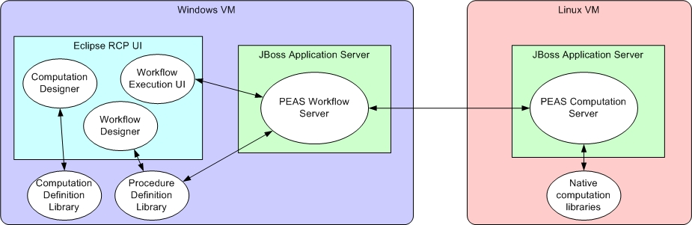
APS-PEAS Prototype Overview
Workflow (XPDL, Designer, Engine)
Language interoperability
Layered/Distributed architecture
RCP UI
TMT.TEL.CDD.XXX.XXX

Slide 10
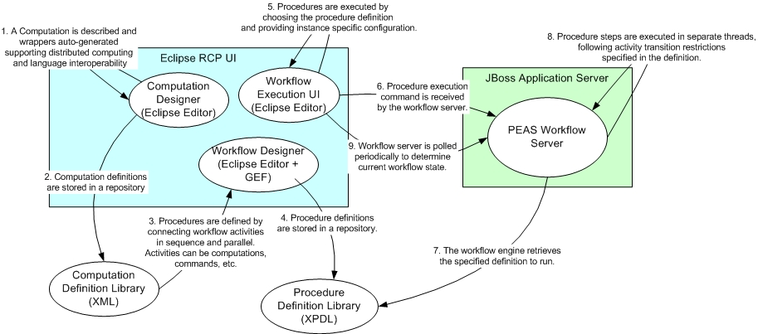
End to End Use Case
TMT.TEL.CDD.XXX.XXX
Notes:
separate this into 3 slides, and run the demo for each use case after each slide

Slide 11
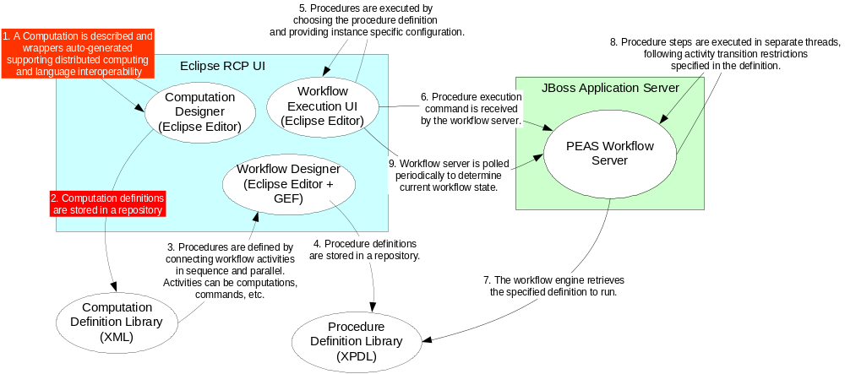
Computation Design Use Case
TMT.TEL.CDD.XXX.XXX
Notes:
separate this into 3 slides, and run the demo for each use case after each slide

Slide 12
Language Interoperability Approaches
Language Interoperability Design in the Prototype
Approaches Considered
  SWIG + Generate ‘C’ code from Fortran definition
  Babel using SIDL derived from Fortran definition
  Jython to Fortran using F2PY (numPy)
  Generate ‘C’ code from Fortran and Java code from ‘C’, creating the solution from scratch using library generation and JNI in a two step process.
From scratch, in-house solution used for prototype
  Provides best experience with underlying technologies. Can better understand the tradeoffs of the other approaches
  Can be used to test performance overhead
  Helps determine risk of building an in-house solution
TMT.TEL.CDD.XXX.XXX

Slide 13
Language Interoperability Design
Language Interoperability Design in the Prototype
JNI Java
Source File
C JNI
Include
Files
Make
Shared
Library
C Wrapper
Source File
Fortran File
Generate
Make
Object
Files
Makefile
Java
JAR File
JAR
Java
Class Files
script
TMT.TEL.CDD.XXX.XXX

Slide 14
Language Interoperability Design
XML Descriptor in Fortran Function Comment Header
C <function name=“sum”>
C <author>Scott Michaels</author>
C <short-desc>A subroutine to add two numbers</short-desc>
C <long-desc>This is a test of the Java to Fortran Interoperability
C code generator</long-desc>
C <args>
C <arg name=“a”>
C <short-desc>The first number to add</short-desc>
C <long-desc></long-desc>
C <data-type>REAL*4</data-type>
C <dimension>0</dimension>
C <in-out>IN</in-out>
C <units>none</units>
C </arg>
C <arg name=“b”>
. . .
C </args>
C </function>
TMT.TEL.CDD.XXX.XXX
Notes:
‘C’ interoperability is easier to do, we get it for free in this approach because it is a subset.

Slide 15
Language Interoperability Issues
Interoperability issues addressed in the prototype
Java does not pass by reference, even object references are passed by value (the value of the pointer is copied and passed).
  One to one mapping of function – method signatures is not possible for output arguments, object wrappers of primitives (Integer, Float, etc) are immutable.
  Java is coded to return a single derived output structure, which is mapped to output parameters from the Fortran/C.
Fortran array to memory mapping is column-major order while C is row-major order.
  This can create confusion and cause mistakes in an interoperable environment.
  General solutions to this may result in performance problems with large arrays.
TMT.TEL.CDD.XXX.XXX

Slide 16
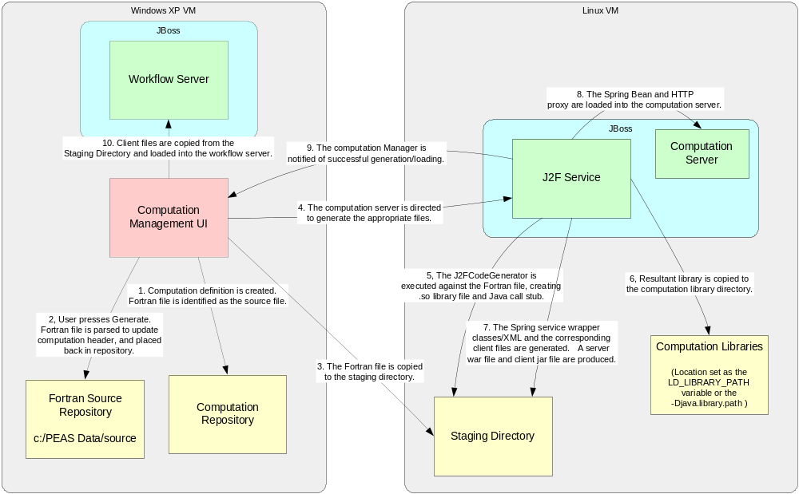
Computation Design and Language
Interoperability
TMT.TEL.CDD.XXX.XXX
Notes:
Do the demo of interoperability after this slide

Slide 17
Computation Design Demo
Computation Designer
Language Interoperability class and library generation
Remoting class and configuration file generation
TMT.TEL.CDD.XXX.XXX

Slide 18
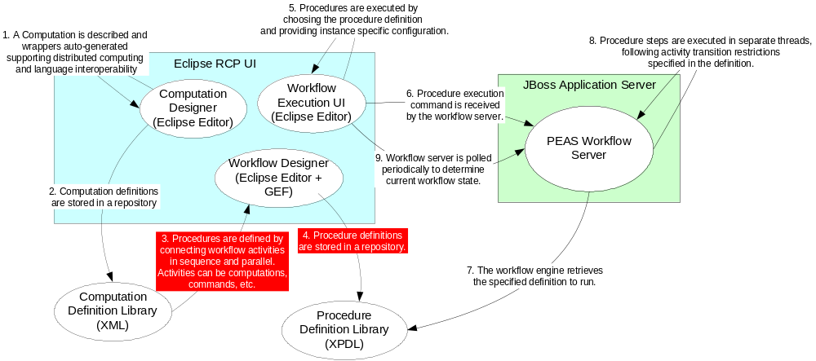
Workflow Designer Use Case
TMT.TEL.CDD.XXX.XXX

Slide 19
Workflow Designer: XPDL
We need to describe how XPDL was used in the workflow designer prototype.
Activities are be categorized as
  Computations
  External Commands
  APS CC Commands
  Real-Time User Interaction
  Real-Time Displays
  Subprocesses

Slide 20
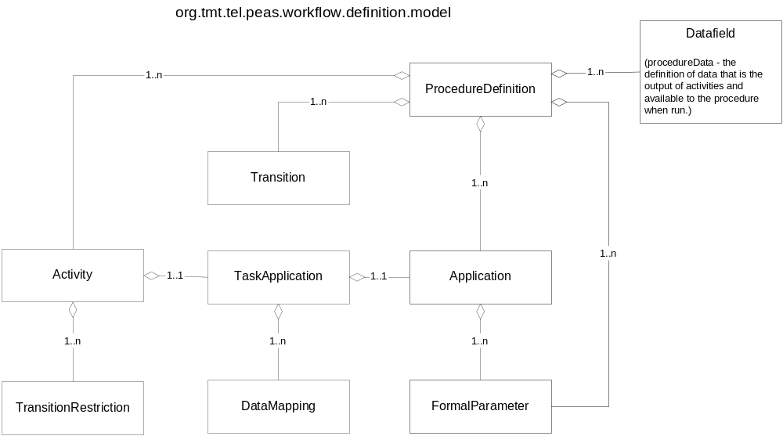
Workflow Designer: Procedure Definition
Procedure Definition Classes
TMT.TEL.CDD.XXX.XXX
Notes:
Add that this maps directly to the portion of XPDL that we require.

Slide 21
Demo: Workflow Designer
Put in highlights of the demonstration
Data mapper

Slide 22
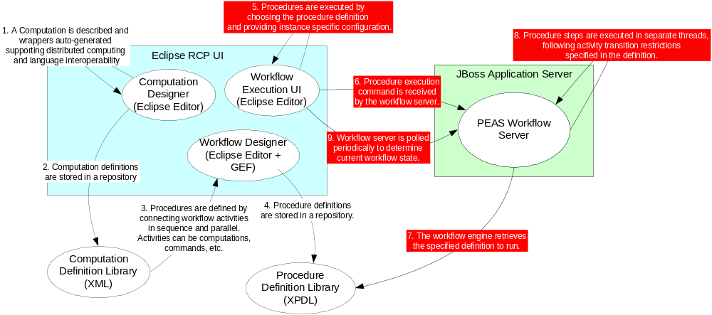
Workflow Engine Use Case
TMT.TEL.CDD.XXX.XXX

Slide 23
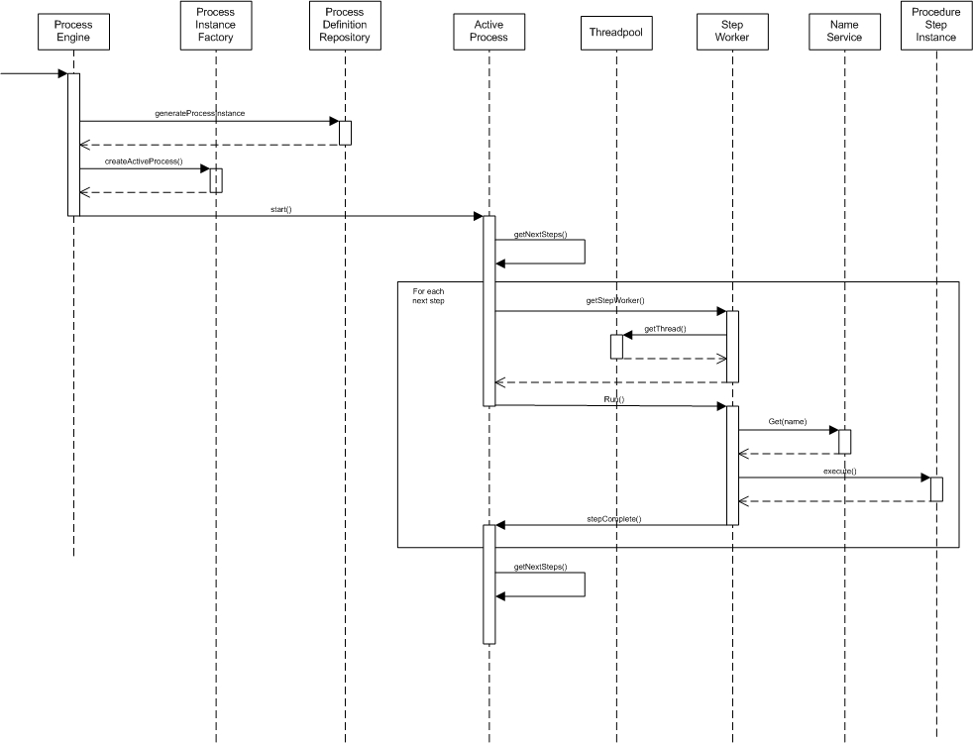
Workflow Engine
Workflow Engine Design
TMT.TEL.CDD.XXX.XXX

Slide 24
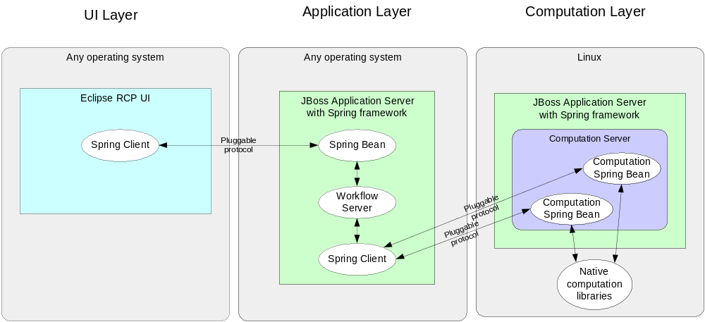
Distributed Architecture
Application server (JBoss) and Spring framework.
TMT.TEL.CDD.XXX.XXX
Notes:
Demo the distributed application after this slide. Run a procedure and note the outputs in each distributed environment.

Slide 25
Workflow Engine and Distributed Architecture Demo
Put in highlights of the demonstration

Slide 26
Rich Client Platform (RCP) UI
Eclipse RCP is used in the prototype
  Eclipse RCP is not Eclipse IDE, but the IDE was created using the RCP.
Features of the Eclipse RCP
  Framework is based on Java SWT
  Framework design concepts well defined
  Windowing mechanisms (positioning, size) come with the framework.
  Plug-in Extension framework is used industry-wide to share and extend UI components.
  GEF plug-in used to easily create drag and drop visual editing for workflow designer.
TMT.XXX.XXX.XXX
TMT.TEL.CDD.XXX.XXX

Slide 27
RCP UI Demo
Workbench Elements
  Windows
  Editors
  Views
  Perspectives
Plug-ins and extension points
PEAS Prototype views, editors
  Designer Perspective
  Execution Perspective
  Diagnostics Perspective

Slide 28
Risk Study Results
Some of the technologies studied were new to the team and required time learning the fundamentals. These activities are not complete.
Lack of telescope software conceptual design and architecture still the greatest risk for APS
Workflow solution is still a viable design for APS
  But the design areas of sub-processes and process looping require more investigation
XDPL contains most all the elements required for APS workflow requirements
  With the exception of loop input/output definition and assignment not yet studied.
  Other workflow languages should be studied.
TMT.TEL.CDD.XXX.XXX
Notes:
First put in a slide that is the same as the original Risk Study slide, but with questions answered – Yes, no, so far.

Slide 29
Risk Study Results
No unanticipated problems were found implementing the XPDL workflow engine in-house; such an approach would not create significant risks to budget or schedule
No unanticipated problems were found implementing an XPDL designer in-house; such an approach would not create significant risks to budget or schedule.
  However, implementation choices of Eclipse RCP and the GEF framework plug-in are essential to this result
No major problems were encountered using the Eclipse RCP as the platform for the APS thick client UI.
  There are some class loader issues that make Eclipse and Spring not play together ‘out of the box’.
  Correct programming of Eclipse RCP will require training
TMT.TEL.CDD.XXX.XXX

Slide 30
Risk Study Results
Using the JBoss application server and Spring framework made the layered and distributed implementation seamless
  This is an area where project-wide technology choices and design constraints may create risks for APS.
Implementation of an automated Java to Fortran language interoperability mechanism is possible.
  Automation schemes require either an Interface Definition (document or parseable header) or be dependent upon a compiler.
  Performance impacts have yet to be determined
  Fortran array-to-memory mapping relative to other languages presents a possibility for errors that an in-house workflow designer might solve.
TMT.TEL.CDD.XXX.XXX

Slide 31
Next Steps
Additional Fortran interoperability prototypes and performance overhead comparison studies:
  SWIG + Generate ‘C’ code from Fortran definition
  Babel using SIDL derived from Fortran definition
  Jython to Fortran using F2PY (numPy)
Study workflow technologies in the area of process loops and sub processes.
Workflow language comparison study
Comparison study of using a commercial or open-source workflow engine
Comparison study of using a commercial or open-source workflow designer product
Architecture studies of APS will not be productive until technology and framework design choices are made by the project.
TMT.TEL.CDD.XXX.XXX
Notes:
Mention ‘C’ interoperability studies, Matlab interoperability studies.

